Slide 1
SQL Project Review
Presenter：Kaiyao Qin & Tao Guo

Slide 2
Project Introduction
Create database about bank transaction information.
There are 17 tables in the database such as customer\account\account type\transaction log etc.
Finish 7 queries like join\select\create view \delete\drop etc.
Also include the where and having conditions.
The goal of the project is to understand database entities in more depth and have practical experience of working with different objects of SQL.

Slide 3
Task Assignment
Task ID | Task Description | Responsible
Phase I
1 | Create first 4 tables | Tao Guo
2 | Create the rest tables | Kaiyao Qin
3 | Combine the query together | Tao Guo
Phase II
4 | Write 1-7 queries | Kaiyao Qin
5 | Check the queries | Tao Guo
6 | Write the report | Kaiyao Qin
7 | Write the PPT | Tao Guo

Slide 4
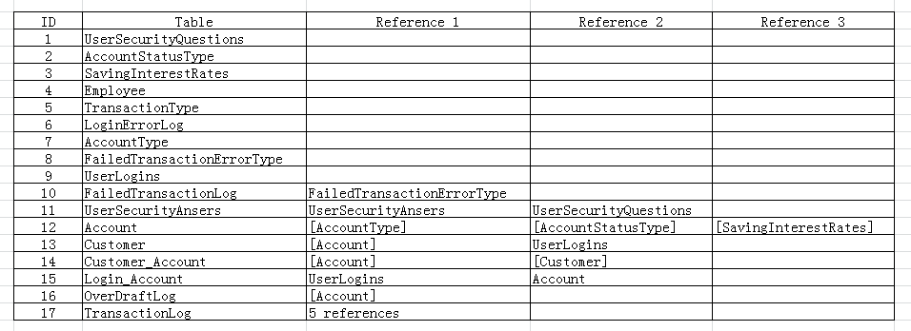
Gain from the project
Create table and insert value sequence is important.
First: No foreign Keys
Second: 1 foreign keys references to no foreign key tables.
The rest.

Slide 5
Gain from the project
Hands-on experience to do more practice.
523 Lines
1506 words
N times Errors

Slide 6
Gain from the project
Try to solve question with in different method
The question:
Create a view to get any particular user’s login and password using AccountId.
Methods:
select * from view where AccountId = n
create procedure to exec
declare variable and set variable

Slide 7
Gain from the project
Nothing is simple
Just do it!
Try it!
Face the Errors!
Solve the Errors!
You will get it!

Slide 8
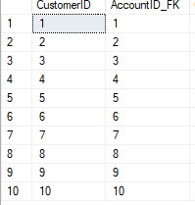
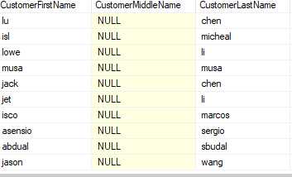
In this bank data base design, a total of 10 customers were created.
Each of them holds an AccountID from 1 to 10
required to directly or indirectly access other tables such as OverDraftLog, Customer, AccountType and etc

Slide 9
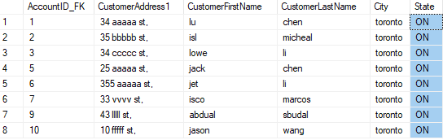
Among these customers, eight are from Ontario state

Slide 10
Only Abdual has the total account balance less than $5000

Slide 11
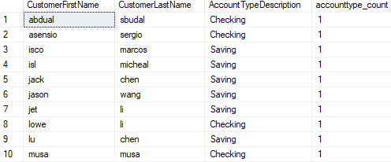
six of them hold saving accounts, and four holds checking account.

Slide 12
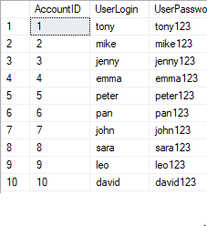
Each customer has a UserlLogin and its corresponding UserPassword, and they can be accessed by AccountID

Slide 13
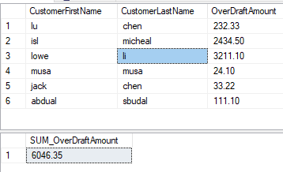
six of the ten customers have overdraft in their accounts
customer Li has overdraft amount over three thousand, which is the most in the list.

Slide 14
Thanks!

